Slide 1
An Investigation of Bias in LAPD traffic stops
Lael Hebert

Slide 2
Problem statement

Slide 3
Problem Statement
Purpose
Identify areas of potential bias within vehicle and pedestrian stops made by the Los Angeles Police Department.
Audiences
Los Angeles Police Department
Citizen groups interested in police-community relations
Goals
Identify target areas within the LAPD that could benefit from interventions such as anti-bias training with the goal of reducing bias and improve relations and trust between police and community.

Slide 4
Data and Methodology

Slide 5
Data Sources
Vehicle and Pedestrian Stop Data 2010 to Present
Main data source
LAPD Reporting districts
Used to determine where a stop occurred
Census_Data_by_Neighborhood_Council
2010 population data for the city of LA, broken down by neighborhood and ethnicity
Map of LAPD divisions
Used to map LAPD divisions to neighborhoods
Map of Los Angeles neighborhoods
Used to map LAPD divisions to neighborhoods
Census.gov
For verifying population distributions
Notes:
1. Vehicle and Pedestrian Stop Data 2010 to Present
+ This is the primary data set for this analysis. It contains records on over 7 million traffic stops. It includes information such as gender and ethnicity of the person stopped as well as information on the officer(s) involved in the stop.
+ Source: csv file from [data.gov](https://catalog.data.gov/dataset/lapd-vehicle-and-pedestrian-stops-2010-present)
+ Additional documentation of data fields at the [City of Los Angeles website](https://data.lacity.org/A-Safe-City/Vehicle-and-Pedestrian-Stop-Data-2010-to-Present/ci25-wgt7)
2. LAPD Reporting districts
+ A list of the reporting districts within Los Angeles and the precinct (division) and bureau associated with each
+ Source: csv file from [City of Los Angeles website](http://geohub.lacity.org/datasets/4398360b1a0242b78904f46b3786ae73_0)
3. Census_Data_by_Neighborhood_Council
+ This data set contains population counts by ethnicity for Los Angeles neighborhood based on the 2010 census.
+ Source: csv file from [data.gov](https://catalog.data.gov/dataset/census-data-by-neighborhood-council)
+ Additional documentation of data fields at the [City of Los Angeles website](https://data.lacity.org/A-Livable-and-Sustainable-City/Census-Data-by-Neighborhood-Council/nwj3-ufba)
4. Map of LAPD divisions from the Los Angeles times
+ This is an interactive map on the [LA Times website](http://maps.latimes.com/lapd/)
+ Clicking on a division leads to information on which neighborhoods the division patrols
5. Map of LA neighborhood councils
+ This is an interactive map of the Los Angeles neighborhood councils https://empowerla.org/city-map/
6. According to the [Census.gov website](https://www.census.gov/quickfacts/fact/table/losangelescitycalifornia,losangelescountycalifornia/POP010210), Los Angeles had a population of 3.79 million people in 2010. This is very close to the 3.73 million reported in our census data set from the neighborhood council. The percentages by each ethnicity also match well. It looks like our calculation for the hispanic population will work.

Slide 6
Cleaning census data
Combined several categories into “Other”
The Hispanic column was missing.
Filled it in by subtracting the sum of all the other ethnicities from the total
Verified percentages with an external data source
Assumption: pop distributions not changing

Slide 7
Structure of LAPD
Bureau – division – basic car unit – reporting district

Slide 8
Population mapping
Manually mapped neighborhood councils to division – not an exact match for every division
Totaled district counts
Joined to stops data

Slide 9
Analysis

Slide 10
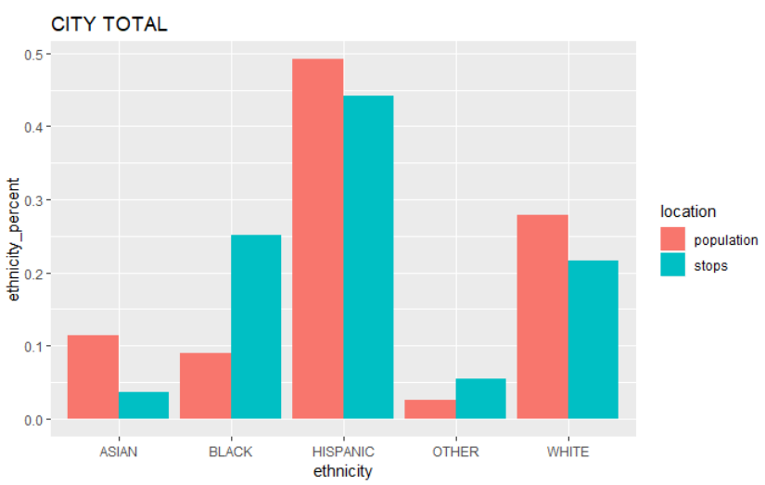
Traffic stops vs population
Blacks are stopped at a much higher rate than other ethnicities
Blacks account for 25% of stops but less than 9% of the city population

Slide 11
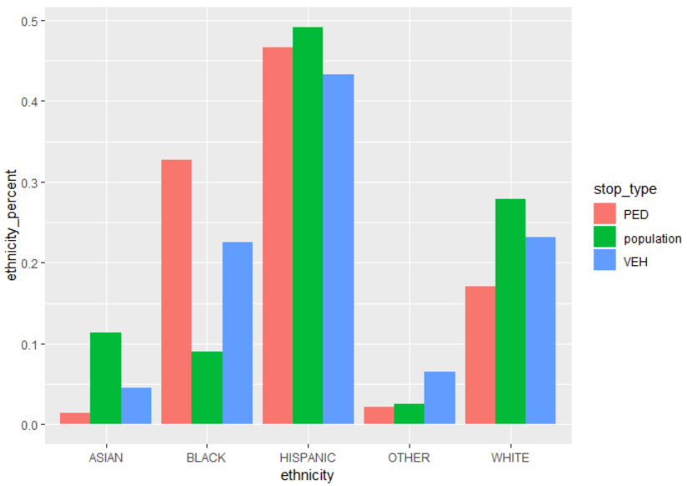
Pedestrian vs vehicular stops
Blacks are more likely to be involved in pedestrian stops
Asians and Whites are more likely to be involved in vehicular stops

Slide 12
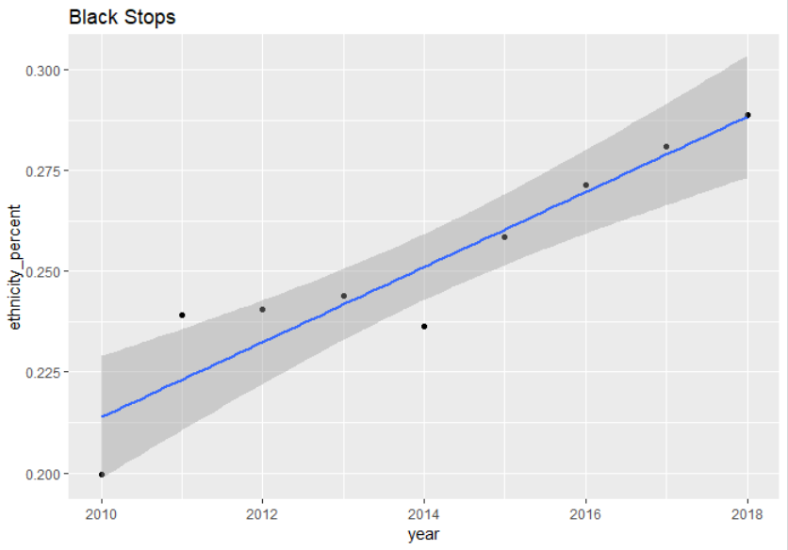
Trends in Black stops

Slide 13
Ethnic breakdown by division Which divisions have a larger percentage of black stops than black population?
All of them

Slide 14
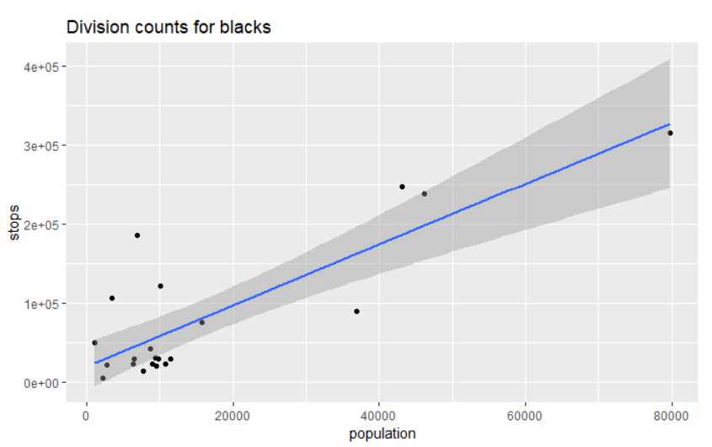
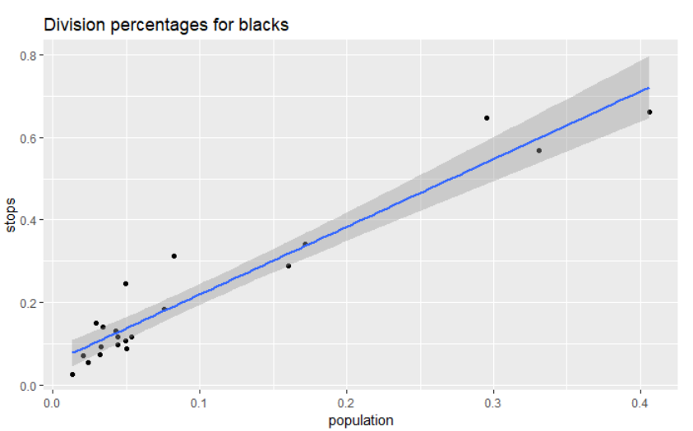
Problem divisions
Southeast
Southwest
Central
Newton
Hollywood
Olympic

Slide 15
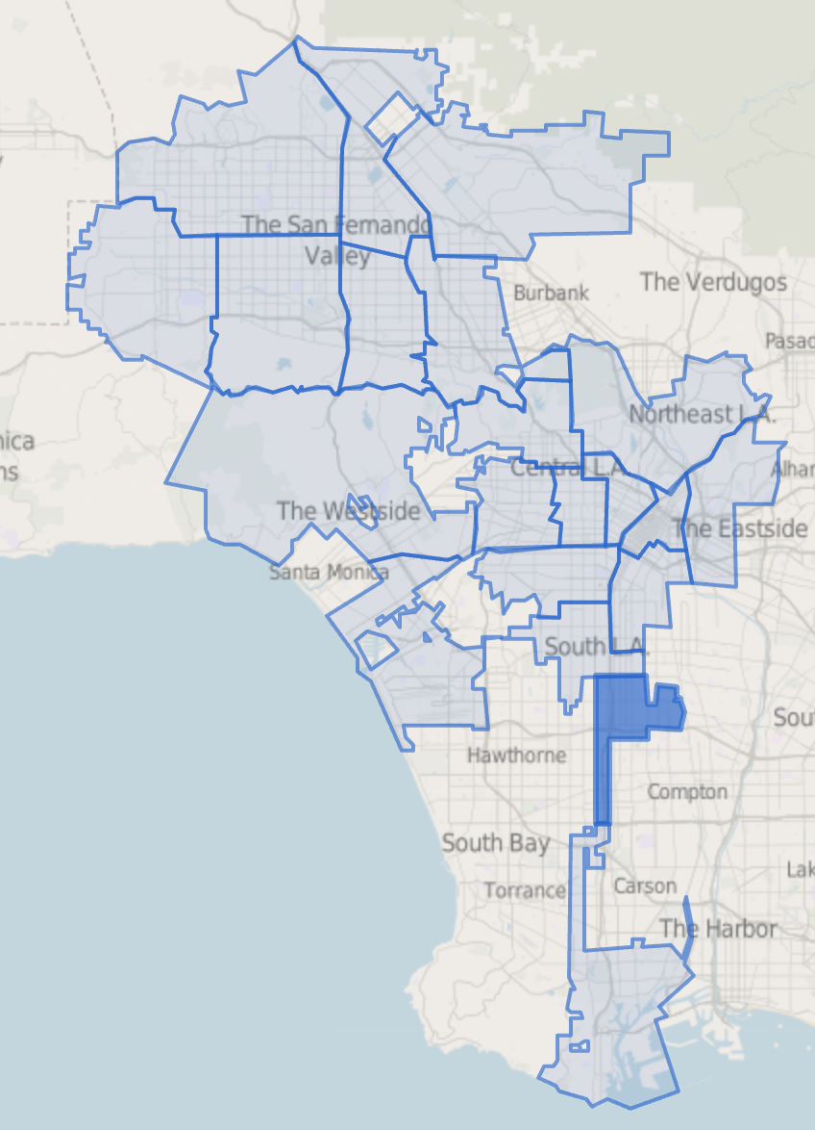
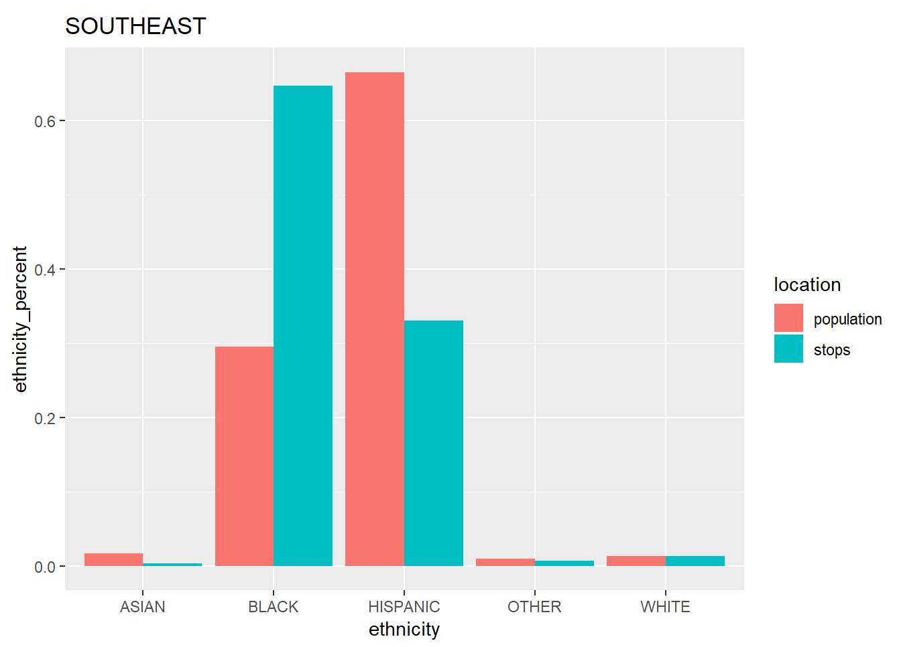
Southeast division
Identification of problem officers. Procedure:
filter to this division
group by officer and calculate number of stops and % black stops by year
determine a minimum threshold for number of stops in either 2018 or 2017 & 2018
determine a threshold % black compared to either population or division stop total. Officers above that will be recommended for anti-bias training

Slide 16
Southwest division
Identification of problem officers. Procedure:
filter to this division
group by officer and calculate number of stops and % black stops by year
determine a minimum threshold for number of stops in either 2018 or 2017 & 2018
determine a threshold % black compared to either population or division stop total. Officers above that will be recommended for anti-bias training

Slide 17
Central division
Identification of problem officers. Procedure:
filter to this division
group by officer and calculate number of stops and % black stops by year
determine a minimum threshold for number of stops in either 2018 or 2017 & 2018
determine a threshold % black compared to either population or division stop total. Officers above that will be recommended for anti-bias training

Slide 18
Newton division
Identification of problem officers. Procedure:
filter to this division
group by officer and calculate number of stops and % black stops by year
determine a minimum threshold for number of stops in either 2018 or 2017 & 2018
determine a threshold % black compared to either population or division stop total. Officers above that will be recommended for anti-bias training

Slide 19
Hollywood division
Identification of problem officers. Procedure:
filter to this division
group by officer and calculate number of stops and % black stops by year
determine a minimum threshold for number of stops in either 2018 or 2017 & 2018
determine a threshold % black compared to either population or division stop total. Officers above that will be recommended for anti-bias training

Slide 20
Olympic division
Identification of problem officers. Procedure:
filter to this division
group by officer and calculate number of stops and % black stops by year
determine a minimum threshold for number of stops in either 2018 or 2017 & 2018
determine a threshold % black compared to either population or division stop total. Officers above that will be recommended for anti-bias training

Slide 21
Conclusions & Recommendations

Slide 22
Conclusion & Recommendations

